Slide 1
The Global Precipitation Measurement (GPM) Mission: NASA Science Status
Gail Skofronick Jackson
GPM Project Scientist
Gail.S.Jackson@nasa.gov
NASA Goddard Space Flight Center
OLYMPEX Meeting
Seattle, WA
21 January 2015
www.nasa.gov/gpm
Twitter: NASA_Rain
Facebook: NASA.Rain

Slide 2
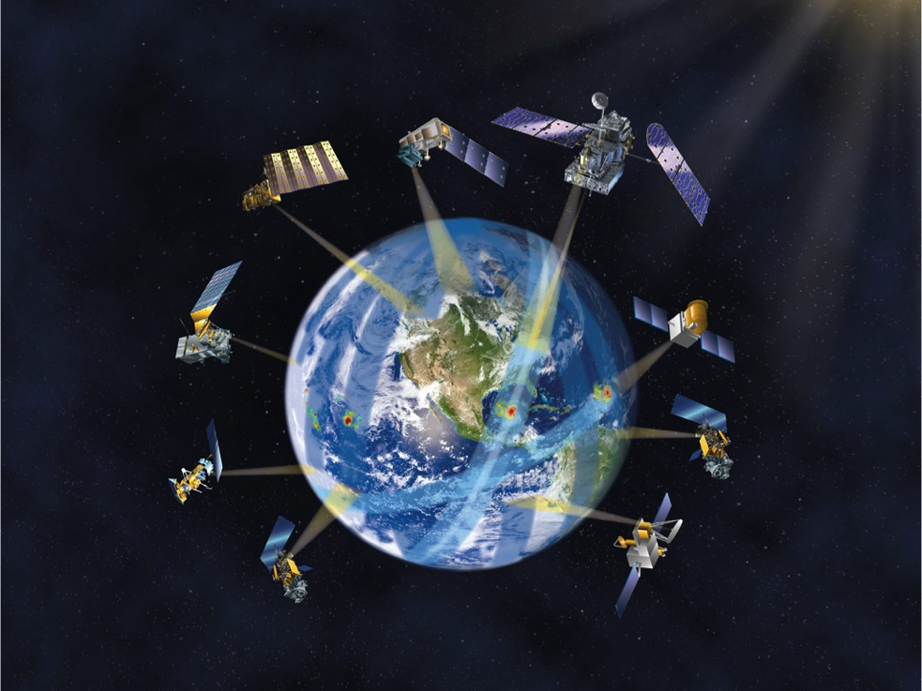
GPM Constellation Concept
GPM Core Observatory
(NASA/JAXA, 2014 )
DPR (Ku & Ka band)
GMI (10-183 GHz)
65º Inclination
407 km altitude
5 km best footprint
0.2 – 110 mm/hr and snow
Lifetime: 3, 5, 15 years
Suomi NPP
(NASA/NOAA)
MetOp B/C
(EUMETSAT)
JPSS-1 (NOAA)
Megha-Tropiques (CNES/ISRO)
NOAA 18/19 (NOAA)
TRMM
(NASA/JAXA)
DMSP F17/F18/F19/F20
(DOD)
GCOM-W1 (JAXA)
Next-Generation Unified Global Precipitation Products Using GPM Core Observatory as Reference
Precipitation rates everywhere in the world every three hours
2
Notes:
GPM establishes a new milestone for international cooperation in Earth science satellite observations. NASA and JAXA are launched the GPM Core Observatory that is designed to work with, and anchor, the constellation of satellites and ground systems from the partner agencies of Japan, Europe, India, as well as U.S. agencies such as NOAA. It will seamlessly combine all the measurements into a single global precipitation data set every 3 hours.
Yellow for launched assets, white for to be launched assets.

Slide 3
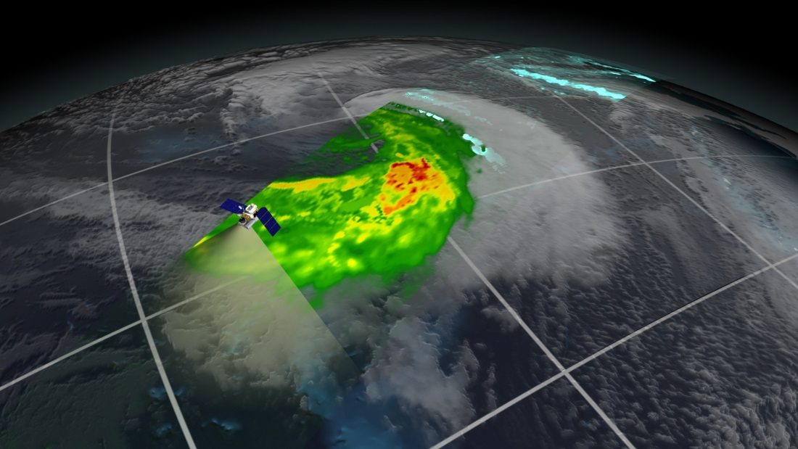
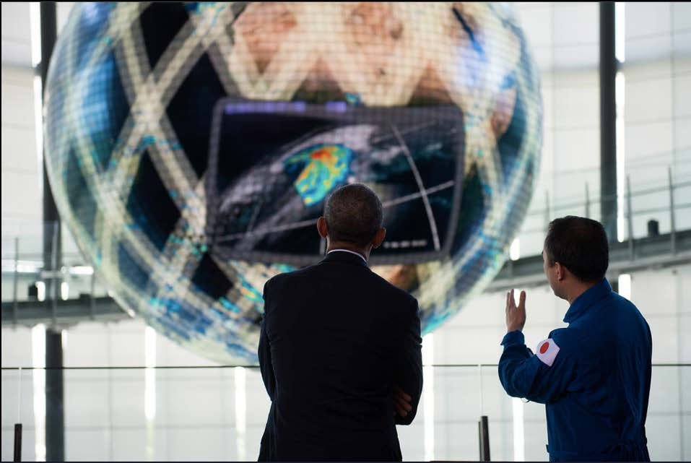
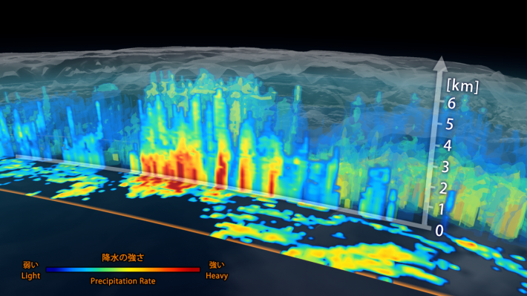
GPM Core: First Light Images Released March 25th 2014
These are the first publically released images from GPM. The images show precipitation falling inside a March 10 extratropical cyclone over the northwest Pacific Ocean, approximately 1,000 miles east of Japan.
GPM Microwave Imager (GMI) retrievals
www.nasa.gov/gpm
Above: Image from GMI showing rain rates across a 885 kilometer swath of an extra-tropical cyclone observed on March 10, 2014. In the northwest part of the storm, the blue areas indicate falling snow.
Below: 3D view of precipitation rate inside the extra-tropical cyclone as viewed by the DPR. Vertical resolution is 250 m, horizontal resolution is ~5 km.
Dual-frequency Precipitation Radar data
President Obama viewing GPM data 4/24
Notes:
These images were the first to be shown to the public during press events March 25th, 2014.
TRMM would not have been able to observe this extratropical cyclone. (The storm was outside TRMM’s sampling area.)
Note the snow retrievals for GMI and the vertical structure shown in DPR.
GMI is like taking an x-ray through the clouds to see the snow and rain within.
DPR is like taking a CAT scan to see the 3D structure of snow and rain from the top of the cloud to the Earth’s surface.
Blue/greens to reds indicate light to heavy precipitation; lightest blue in GMI retrievals shows locations of falling snow.
Need internet to get movies to work.

Slide 4
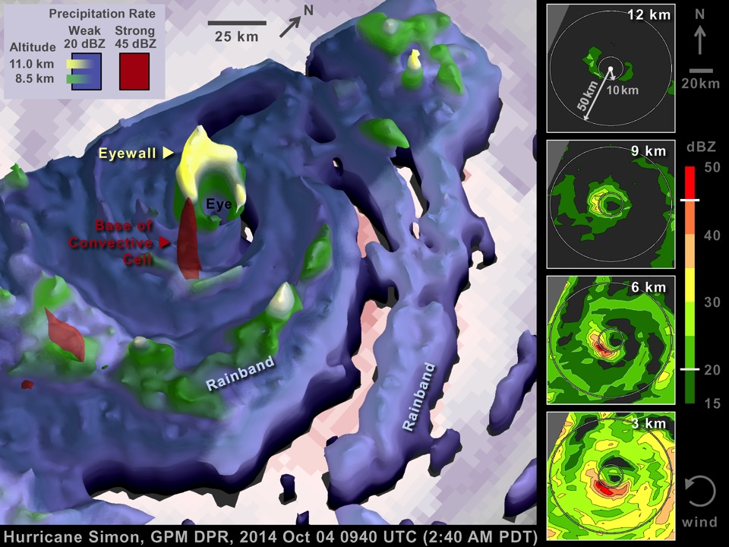
 | 10 GHz | 19 | 23 | 36
TMI | 48 km | 24 | 22 | 13
GMI | 26 | 15 | 12 | 11

Slide 5
GPM Core Observatory: New Scientific Capabilities
Notes:
This image shows the power of the new capabilities on GPM. Namely the Ka radar frequency that is able to reveal the 3D structures of ice and light precipitation (because of its lower minimum detectable reflectivity down to 12 dBZ). Note the yellow anvil region coming out of the edges of the cyclone hot tower at the 10 km altitude. The GMI also has 166 and 183 GHz channels (that TRMM did not have). These channels are also sensitive to light rain and ice. One can see the depression in brightness temperatures in 183 GHz where the anvil ice exists. Note that 89 and 37 GHZ are sensitive to only the most intense precipitation areas. Also that 37 GHz warms when liquid precipitation is present. These GMI brightness temperature relationships are as expected over oceans.

Slide 6
Precipitation Products and Release Schedule
First reprocessing scheduled in 2015

Slide 7
IMERG 1-3 June 2014
Uses multi-satellite inter-calibrated precipitation data

Slide 8
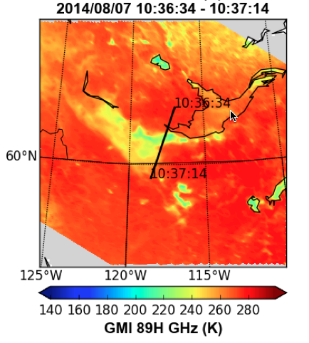
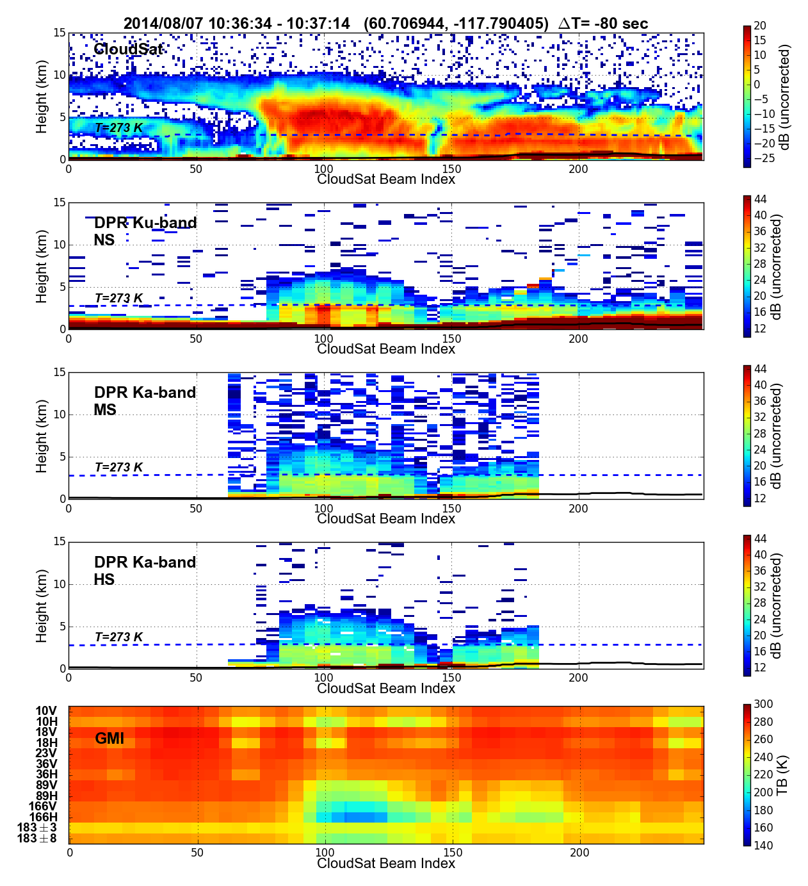
GPM/CloudSat Matchup (The Future?)
2014/08/07 1036 UTC Northern Canada
GPROF retrievals very similar to radar retrievals in rain location and intensity
Courtesy Joe Turk

Slide 9
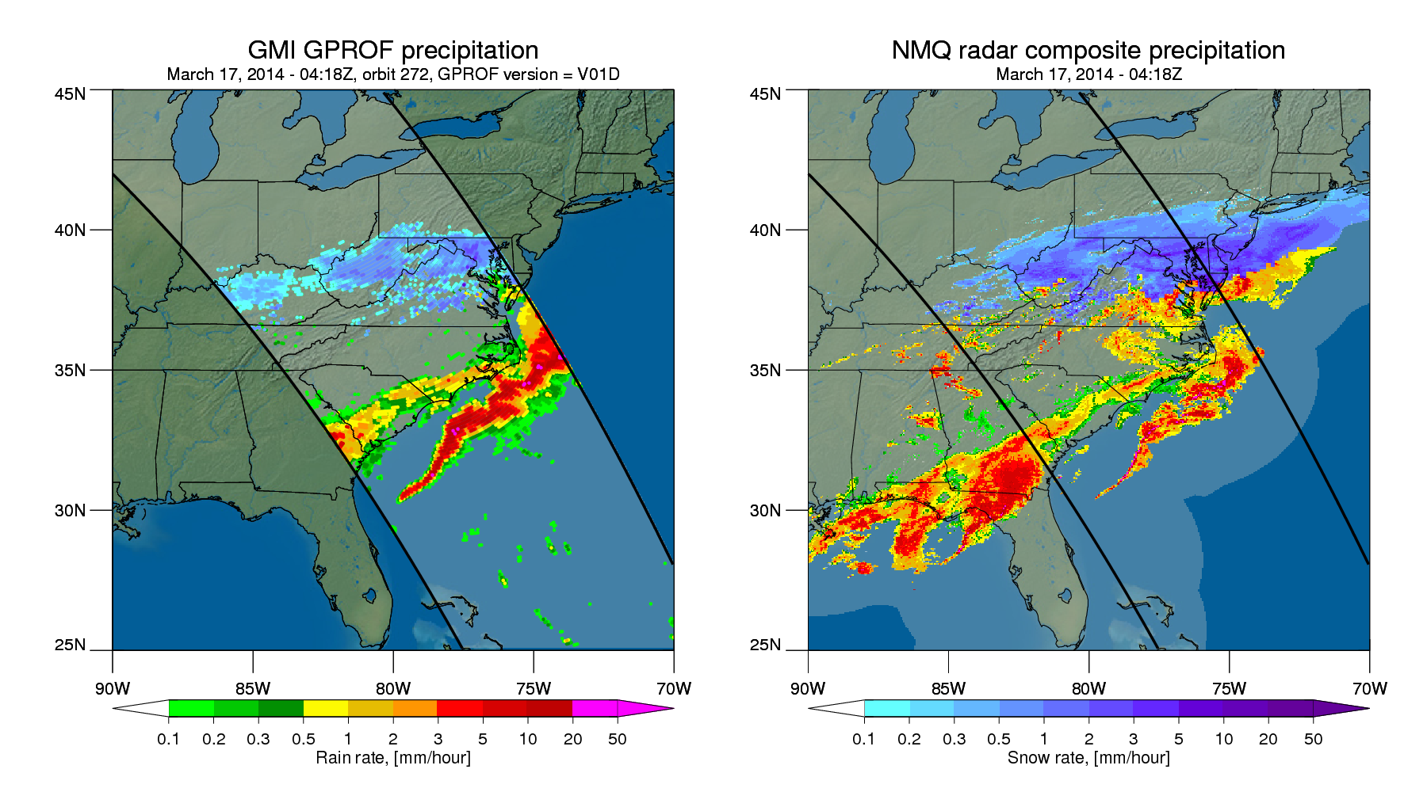
Falling Snow as Observed by GMI
NASA's GPM Microwave Imager (GMI) was specifically designed to detect falling snow. This snow event occurred March 17, 2014 and deposited more than 7” of snow in the Washington, DC metro area.
Bottom Left: GMI retrievals of liquid rain (greens to reds indicate light to heavy rain) and falling snow (blue shading).
Bottom Right: Ground measurements from NOAA’s National Mosaic & Multi-Sensor QPE (CONUS 3D radar mosaic at 1km resolution).
GMI
Retrievals
Ground
Data
Courtesy Kummerow/Berg
Notes:
These images represent one of the first good cases of falling snow as observed by GMI.
The GMI retrieval (GPROF) is still undergoing validation and the NMQ ground data is not a perfect representation of the ground truth, however the rain and snow structures are similar as are the rates. Retrievals of mixed precipitation (melting snow or rain and snow together) still need additional efforts.

Slide 10
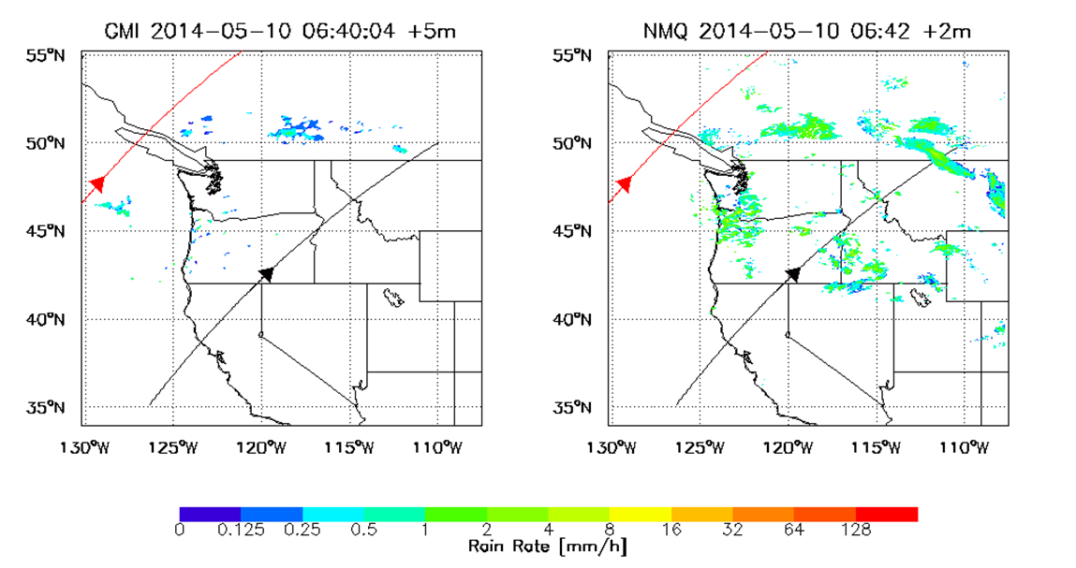
OLYMPEX AREA 5/10/2014 (Low ML steady moving showers)

Slide 11
GPM Project Level 1 Requirements
Science Requirements
Meas. of the same geophysical scenes using both active and passive technique from 65N to 65S lat with mean sampling time of 24 hrs
DPR, Ku/Ka bands
Quantify rain rates between 0.22 and 110 mm/hr
Detection of snowfall at effective resolution of 5 km
GMI, multi-channel wide-band
Quantify rain rates between 0.2 and 60 mm/hr
Detection of snowfall at effective resolution of 15 km
Estimate precipitation particle size distribution
Rain rate biases between the ground-based and space-based estimates at 50 km resolution <50% at 1 mm/hr; <25% at 10 mm/hr
Rain rate random error between the ground-based and space-based estimates at 50 km res <50% at 1 mm/hr; <25% at 10 mm/hr
Standard data products (level 1, 2, 3) and docum. available to all users
Combined radar/radiometer swath products available within 3 hours of observation time, 90% of the time
Radiometer precipitation products available within 1 hour of observation time, 90% of the time

Slide 12
Ground Validation Overarching Objectives
GPM GV Overarching Approaches
Direct: Statistical validation via comparison to reliable ground networks
Physical: Precipitation and cloud microphysics studies to test/improve algorithms
Integrated: Understanding of product utility w/impacts of uncertainty in hydrologic, climate, weather and related applications
GPM OLYMPEX General Objectives
Datasets to enable:
Physical validation* of DPR and radiometer algorithms in mid-lat cold season frontal systems over complex terrain, ocean (light-heavy rain, mixed, snow)
Direct/Integrated hydrologic validation over cold season complex terrain
Exploration of “level IV” merged model/obs/satellite precipitation estimation
*Sidebar: Previous algorithm developer comments/desires specific to OLYMPEX……:
Ensure well calibrated instruments producing near collocated data (Ocean/Land)
Closely coordinate MF-radar/radiometer and in situ microphysical profiles along ground-based radar & disdrometer radials (ice/liquid PSD, type, q_{i,l}-contents)
Collect surface reference ε and σ₀ data over land in rain-free conditions
Provide estimates of seasonal/basin integrated snow water equivalent
Collect T/P/RH sounding profiles
Coordinate aircraft/ground instruments with GPM overpass(es)
Notes:
PI = Principal Investigator

Slide 13
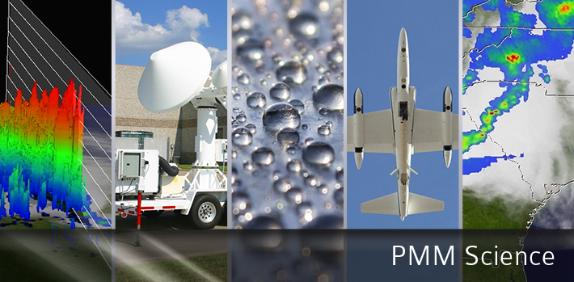
For more information on the TRMM and GPM Missions:
http://gpm.nasa.gov
www.nasa.gov/gpm
Twitter: NASA_Rain Facebook: NASA.Rain
Notes:
Gail/Dalia

