Slide 1
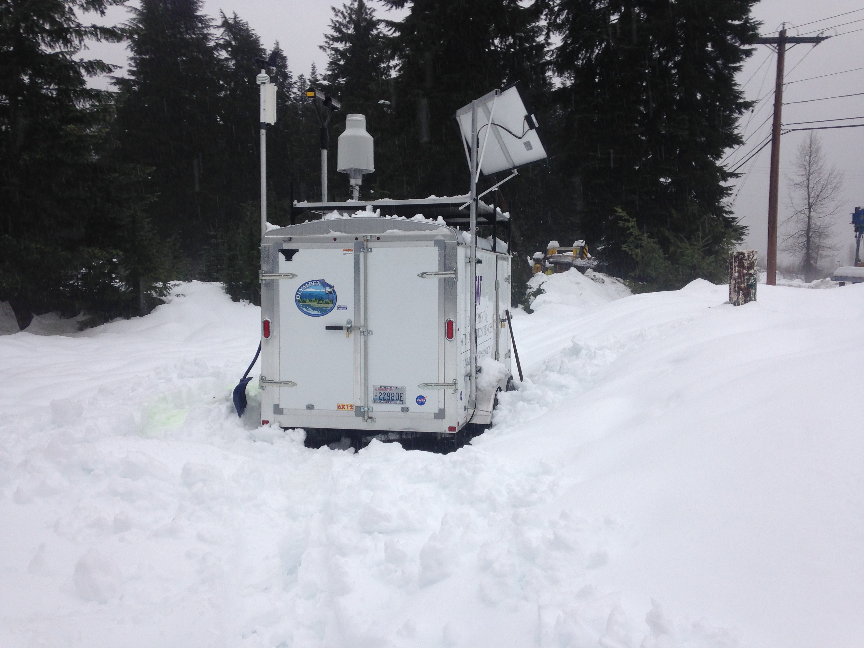
OLYMPEX Ground Instruments
Joe Zagrodnik

Slide 2
Olympic Peninsula Overview
x
Legend
= WSR-88D
= NPOL
= DOW
= EC X-Band
= MRR = SNOTEL
= Ground Obs sites
= Snow camera network = UW Tipping bucket network
= Chehalis rain gauge network
x
x
x
x
x
x
x
x
x
x
x

Slide 3
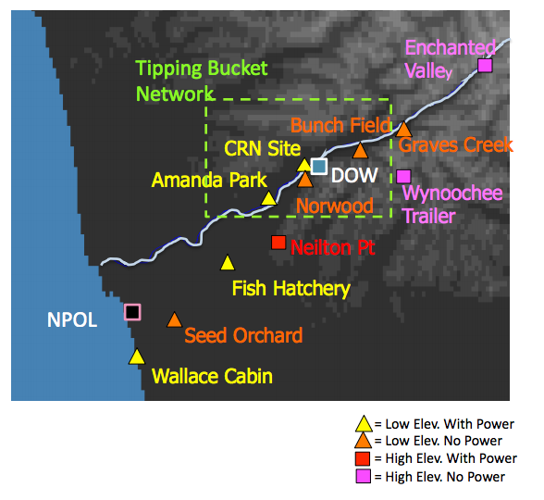
Ground Sites--Windward side of Olympics/Quinault Valley

Slide 4
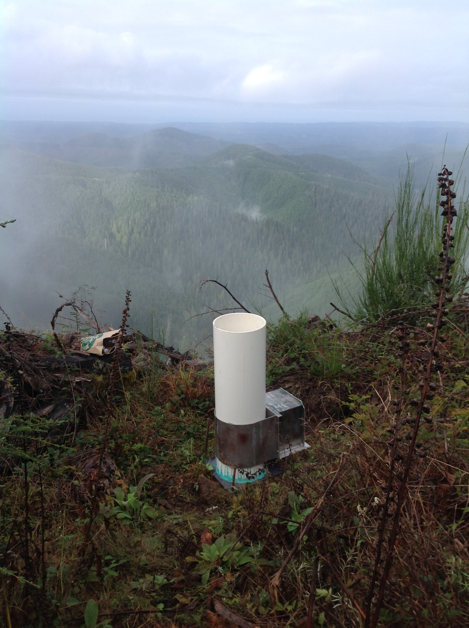
UW Tipping Bucket Network
Locations:
*Data logging only, no data transmission
Notes:
Some may be replaced with NASA’s dual tipping buckets to gain real-time data. However, vandalism is a known issue with sites on the north shore ridges

Slide 5
Name | Elev | Instruments X = currently deployed, P = Planned, U = Possible/Under Discussion |  |  |  |  |  |  |  | Power | Access
 |  | MRR | PIP | 2DVD | Parsivel | Pluvio | Hot Plate | Dual Tipping Gauge | Other
Lee Side
Hurricane Ridge | 5140’ | X | X |  | X |  | X |  |  | Yes | Road, Winter Conditions
Windward side (Quinault Valley region)
Wallace Cabin | Sea level | U |  | U | P |  |  |  | X= Tip Gauge | Yes | Road
Seed Orchard | 255’ |  |  |  | P |  |  | P |  | No | Road
Fish Hatchery | 170’ | P |  | P | X |  |  | X |  | Yes | Road
Amanda Park | 290’ |  |  | P |  |  |  | P |  | Yes | Road
Norwood South Shore Road | 220’ |  |  | U | P |  |  | P |  | Maybe | Road
Bunch Field | 380’ |  |  |  | U |  |  | P | X | No | Road, short walk
CRN Site | 285’ | P |  | P | P |  |  |  |  | Yes | Road
Graves Creek Campground | 563’ |  |  |  | P | U |  | P |  | No | Road and Trail
Neilton Pt | 2156’ | U | U | P | P | P | U |  |  | Yes | Road, Winter Conditions
Enchanted Valley | 2033’ |  |  |  | P | P |  |  |  | No | Trail
Wynoochee Trailer | 3160’ |  |  |  | X | X |  |  |  | No | Road, winter conditions, trail
Notes:
Explain format of table without details—go over sites, instruments, and power/access (by color)
----- Meeting Notes (1/20/15 15:22) -----
Change P* to something else`

Slide 6
Name | Elev | Instruments X = currently deployed, P = Planned, U = Possible/Under Discussion |  |  |  |  |  |  |  | Power | Access
 |  | MRR | PIP | 2DVD | Parsivel | Pluvio | Hot Plate | Dual Tipping Gauge | Other
Lee Side
Hurricane Ridge | 5140’ | X | X |  | X |  | X |  |  | Yes | Road, Winter Conditions
Windward side (Quinault Valley region)
Wallace Cabin | Sea level | U |  | U | P |  |  |  | X= Tip Gauge | Yes | Road
Seed Orchard | 255’ |  |  |  | P |  |  | P |  | No | Road
Fish Hatchery | 170’ | P |  | P | X |  |  | X |  | Yes | Road
Amanda Park | 290’ |  |  | P |  |  |  | P |  | Yes | Road
Norwood South Shore Road | 220’ |  |  | U | P |  |  | P |  | Maybe | Road
Bunch Field | 380’ |  |  |  | U |  |  | P | X | No | Road, short walk
CRN Site | 285’ | P |  | P | P |  |  |  |  | Yes | Road
Graves Creek Campground | 563’ |  |  |  | P | U |  | P |  | No | Road and Trail
Neilton Pt | 2156’ | U | U | P | P | P | U |  |  | Yes | Road, Winter Conditions
Enchanted Valley | 2033’ |  |  |  | P | P |  |  |  | No | Trail
Wynoochee Trailer | 3160’ |  |  |  | X | X |  |  |  | No | Road, winter conditions, trail
Notes:
Move Pluvio
----- Meeting Notes (1/20/15 15:29) -----
U for under discussion
Take P* off of MRR Wallace Cabin, set on Neilton Pt

Slide 7
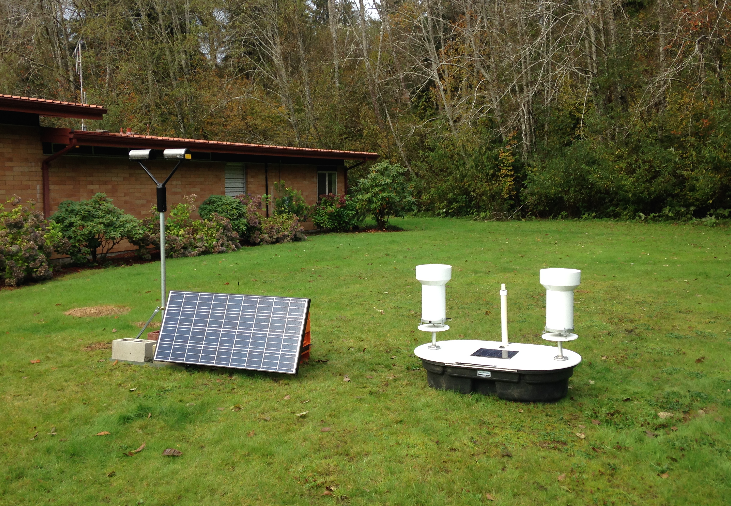
Low Elevation with Power
Data recording/transmission:
Cell coverage
Accessibility:
Paved roads
Maintenance:
Monitor via cell network
Service when needed
Swap gauge platform batteries every 4-6 weeks
Fish Hatchery
Notes:
Remove instrument listing (mention instruments on previous slide)

Slide 8
Name | Elev | Instruments X = currently deployed, P = Planned, U = Possible/Under Discussion |  |  |  |  |  |  |  | Power | Access
 |  | MRR | PIP | 2DVD | Parsivel | Pluvio | Hot Plate | Dual Tipping Gauge | Other
Lee Side
Hurricane Ridge | 5140’ | X | X |  | X |  | X |  |  | Yes | Road, Winter Conditions
Windward side (Quinault Valley region)
Wallace Cabin | Sea level | U |  | U | P |  |  |  | X= Tip Gauge | Yes | Road
Seed Orchard | 255’ |  |  |  | P | P |  | P |  | No | Road
Fish Hatchery | 170’ | P |  | P | X |  |  | X |  | Yes | Road
Amanda Park | 290’ |  |  | P |  |  |  | P |  | Yes | Road
Norwood South Shore Road | 220’ |  |  | U | P |  |  | P |  | Maybe | Road
Bunch Field | 380’ |  |  |  | U |  |  | P | X | No | Road, short walk
CRN Site | 285’ | P |  | P | P |  |  |  |  | Yes | Road
Graves Creek Campground | 563’ |  |  |  | P | U |  | P |  | No | Road and Trail
Neilton Pt | 2156’ | U | U | P | P |  | U |  |  | Yes | Road, Winter Conditions
Enchanted Valley | 2033’ |  |  |  | P | P |  |  |  | No | Trail
Wynoochee Trailer | 3160’ |  |  |  | X | X |  |  |  | No | Road, winter conditions, trail

Slide 9
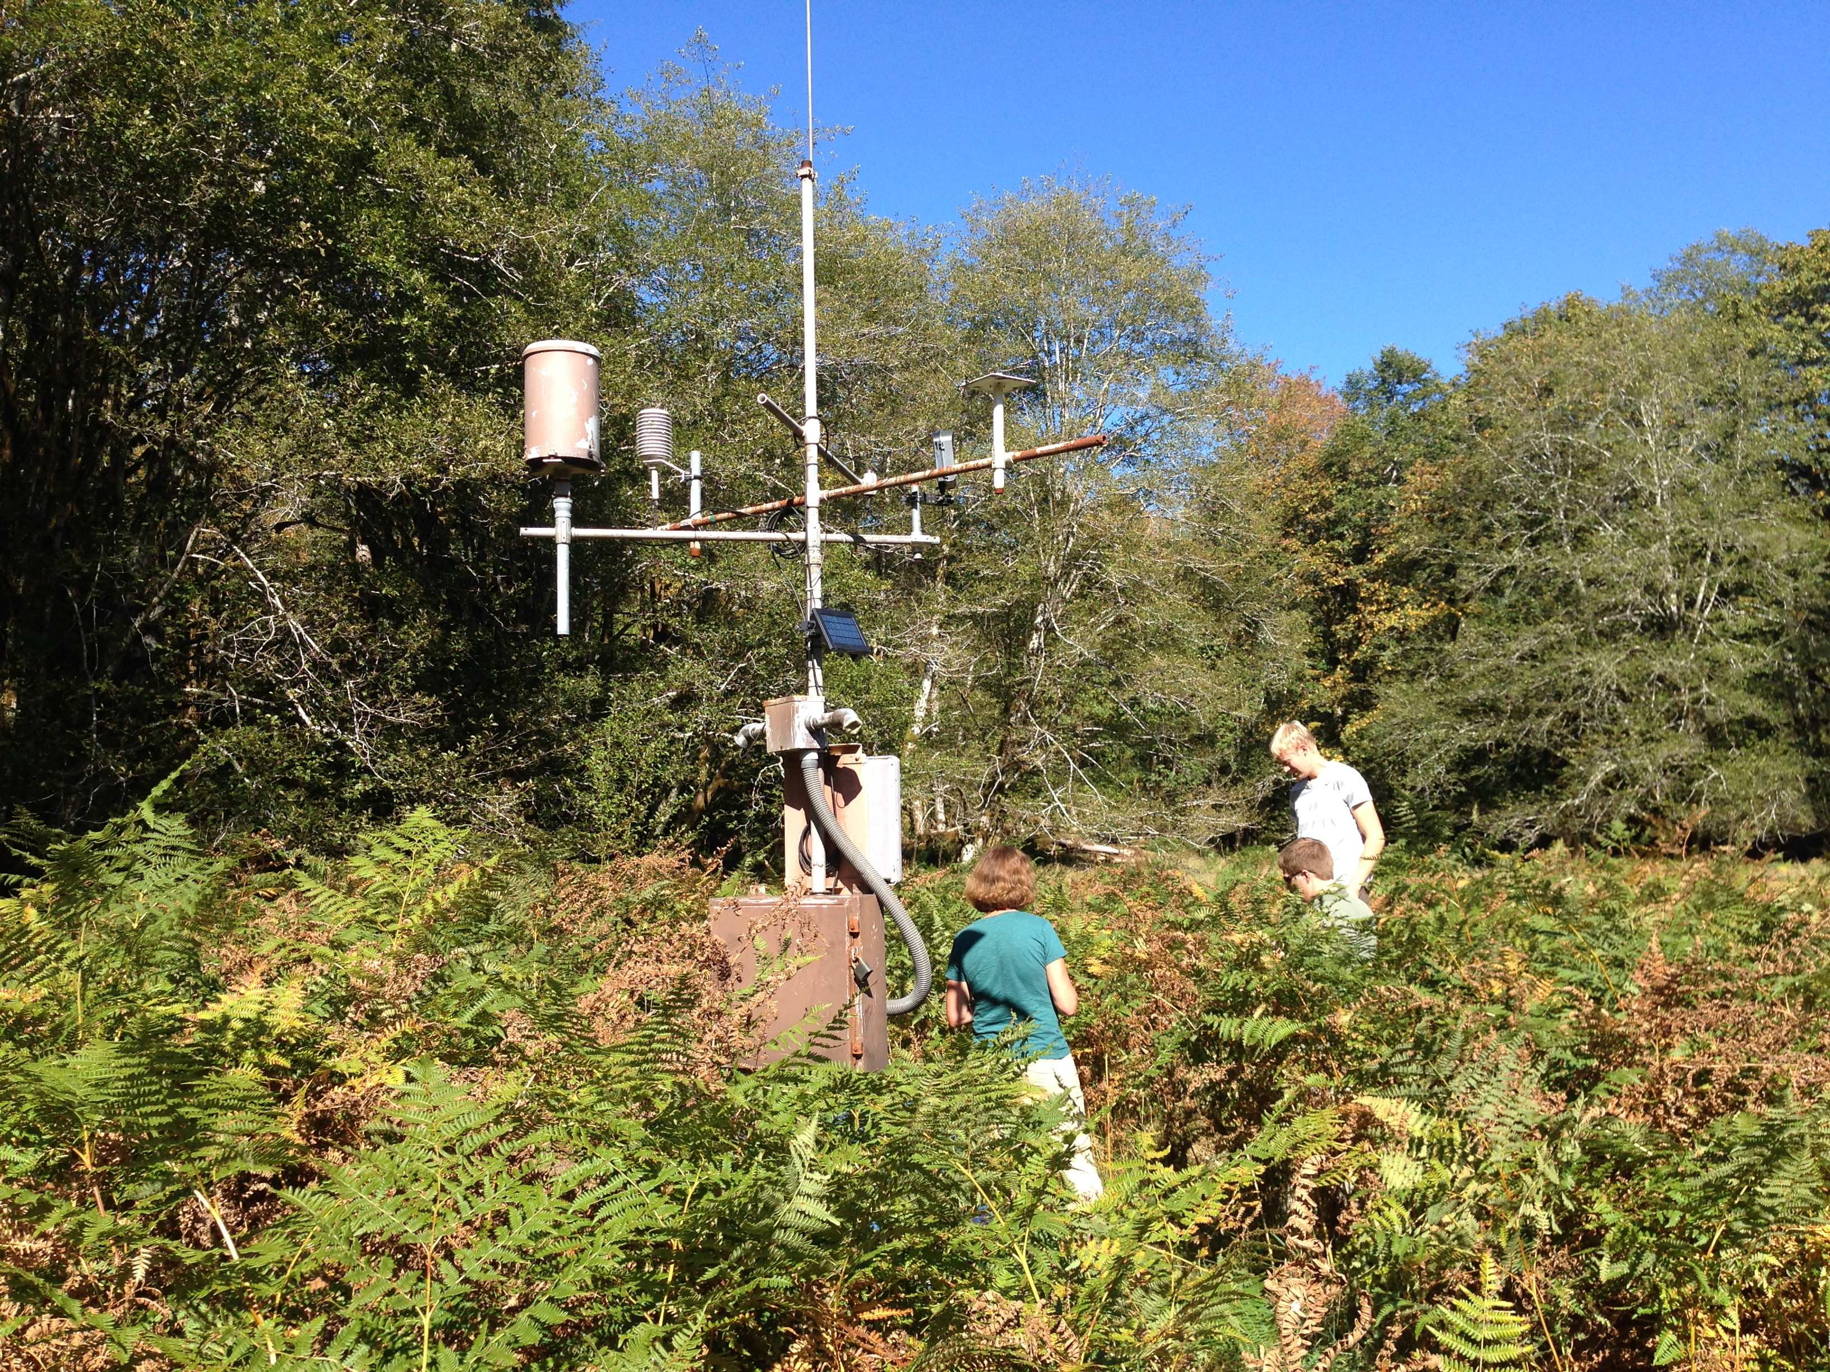
Low Elevation, No Power
Powered by solar panel + 1-2 batteries
Data transmission/recording:
Cell (where available)
Accessibility:
Road, short trails
Maintenance:
Swap batteries
Empty Pluvio after 16” of precip (or major event)
Bunch Field

Slide 10
Name | Elev | Instruments X = currently deployed, P = Planned, U = Possible/Under Discussion |  |  |  |  |  |  |  | Power | Access
 |  | MRR | PIP | 2DVD | Parsivel | Pluvio | Hot Plate | Dual Tipping Gauge | Other
Lee Side
Hurricane Ridge | 5140’ | X | X |  | X |  | X |  |  | Yes | Road, Winter Conditions
Windward side (Quinault Valley region)
Wallace Cabin | Sea level | U |  | U | P |  |  |  | X= Tip Gauge | Yes | Road
Seed Orchard | 255’ |  |  |  | P |  |  | P |  | No | Road
Fish Hatchery | 170’ | P |  | P | X |  |  | X |  | Yes | Road
Amanda Park | 290’ |  |  | P |  |  |  | P |  | Yes | Road
Norwood South Shore Road | 220’ |  |  | U | P |  |  | P |  | Maybe | Road
Bunch Field | 380’ |  |  |  | U |  |  | P | X | No | Road, short walk
CRN Site | 285’ | P |  | P | P |  |  |  |  | Yes | Road
Graves Creek Campground | 563’ |  |  |  | P | U |  | P |  | No | Road and Trail
Neilton Pt | 2156’ | U | U | P | P | P | U |  |  | Yes | Road, Winter Conditions
Enchanted Valley | 2033’ |  |  |  | P | P |  |  |  | No | Trail
Wynoochee Trailer | 3160’ |  |  |  | X | X |  |  |  | No | Road, winter conditions, trail

Slide 11
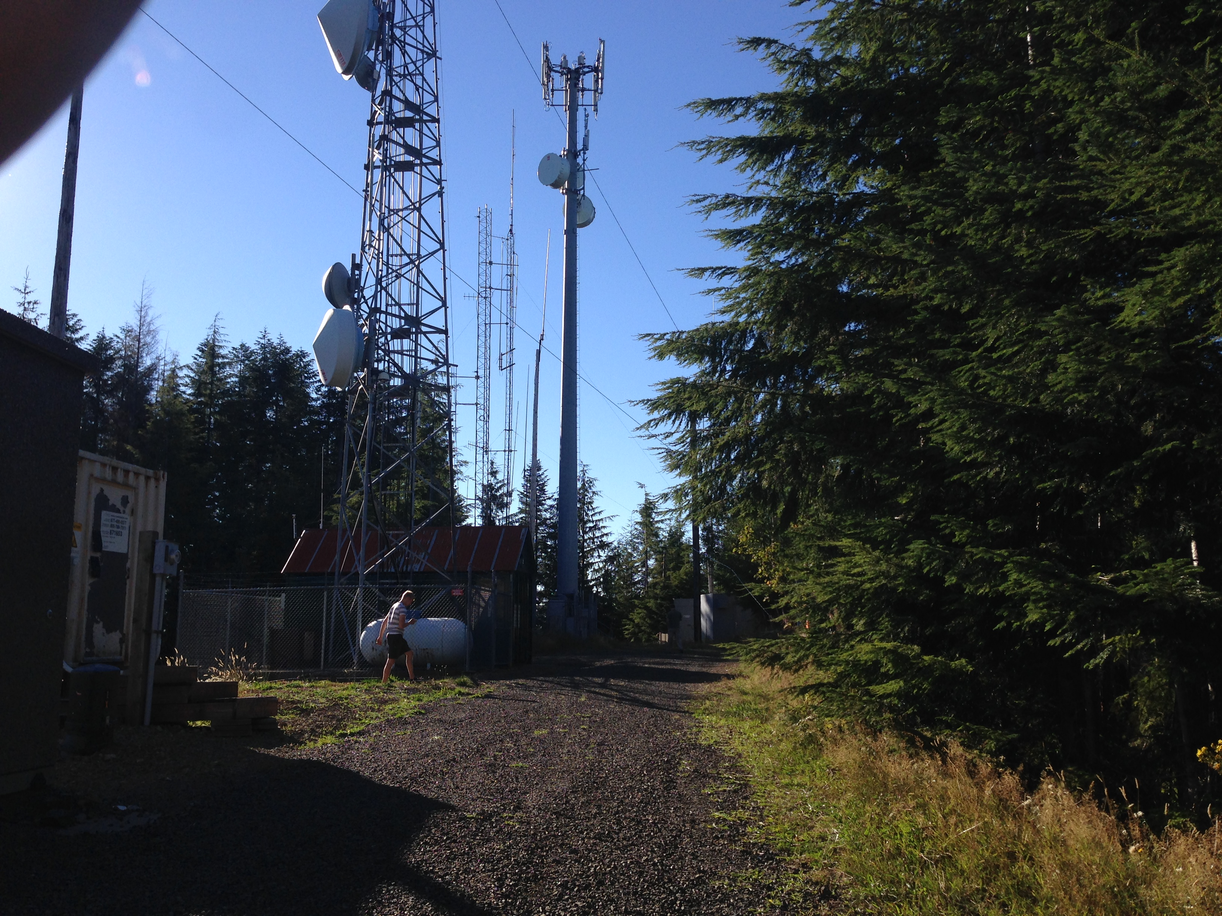
High Elevation with Power
Data recording/transmission:
Cell coverage
Accessibility:
6-mile dirt road (Neilton Pt.)
Winter conditions (blowdowns, snow, mudslides)
Maintenance:
Monitor via cell network
Snow/rime removal
Empty Pluvio after 16” of precip (or major event)
Neilton Pt.

Slide 12
Name | Elev | Instruments X = currently deployed, P = Planned, U = Possible/Under Discussion |  |  |  |  |  |  |  | Power | Access
 |  | MRR | PIP | 2DVD | Parsivel | Pluvio | Hot Plate | Dual Tipping Gauge | Other
Lee Side
Hurricane Ridge | 5140’ | X | X |  | X |  | X |  |  | Yes | Road, Winter Conditions
Windward side (Quinault Valley region)
Wallace Cabin | Sea level | U |  | U | P |  |  |  | X= Tip Gauge | Yes | Road
Seed Orchard | 255’ |  |  |  | P |  |  | P |  | No | Road
Fish Hatchery | 170’ | P |  | P | X |  |  | X |  | Yes | Road
Amanda Park | 290’ |  |  | P |  |  |  | P |  | Yes | Road
Norwood South Shore Road | 220’ |  |  | U | P |  |  | P |  | Maybe | Road
Bunch Field | 380’ |  |  |  | U |  |  | P | X | No | Road, short walk
CRN Site | 285’ | P |  | P | P |  |  |  |  | Yes | Road
Graves Creek Campground | 563’ |  |  |  | P | U |  | P |  | No | Road and Trail
Neilton Pt | 2156’ | U | U | P | P | P | U |  |  | Yes | Road, Winter Conditions
Enchanted Valley | 2033’ |  |  |  | P | P |  |  |  | No | Trail
Wynoochee Trailer | 3160’ |  |  |  | X | X |  |  |  | No | Road, winter conditions, trail
Notes:
Talk about spectrum of capability/utility—from yellow to purple say how they gradually become less capable/more difficult

Slide 13
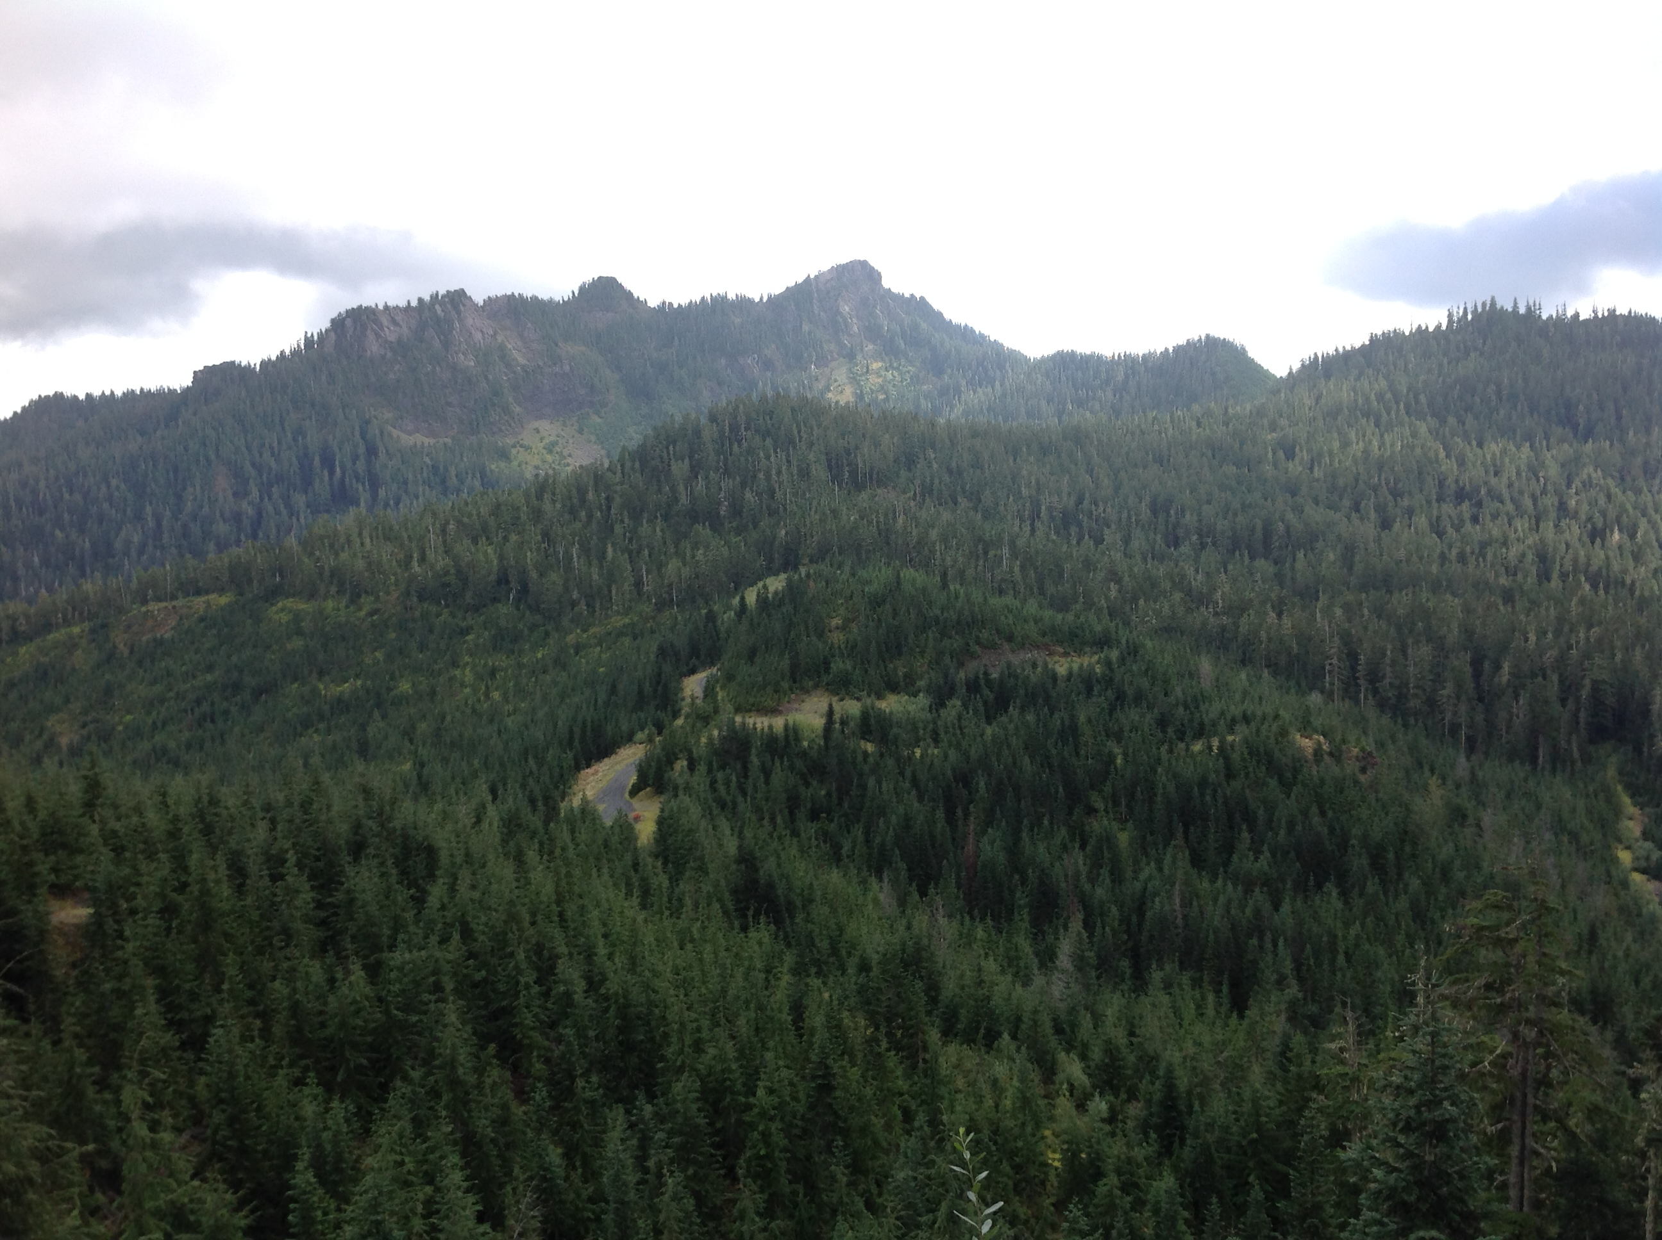
High Elevation, No Power
Powered by solar panel + 8 deep cycle batteries
Data recording/transmission:
No cell coverage
Accessibility:
Enchanted Valley:
13-mile backcountry trail
Wynoochee
7-mile unmaintained gated road
Winter conditions (deep snow, blowdowns, mudslides)
Maintenance:
Visit every 2-3 weeks
Snow/rime removal
Empty Pluvio
Recharge batteries if insufficient solar
Wynoochee
Notes:
Enchanted valley—hiking is only option, mules likely needed for deployment
Wynoochee—road poorly marked, likely blocked by blowdowns and/or mudslides

Slide 14
2014-2015 Test Results
Trailer simulating high elevation, no power
Currently located at Snoqualmie Pass (Elev: 3,000’) in Cascades
8 deep-cycle batteries + solar panel
Parsivel, Pluvio
Real time monitoring
via cell network

Slide 15
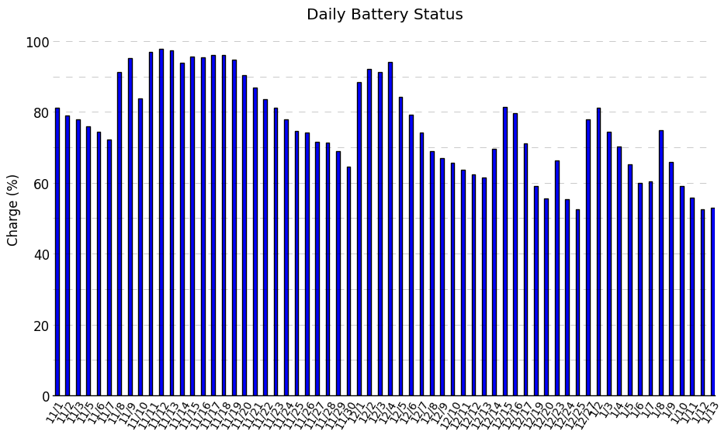
Snoqualmie Pass Trailer Battery
Sunny periods
(Set of 8 batteries + solar panel)
Notes:
Point out downward trend…trailer is in favorable location, Olympics are more cloudy

Slide 16
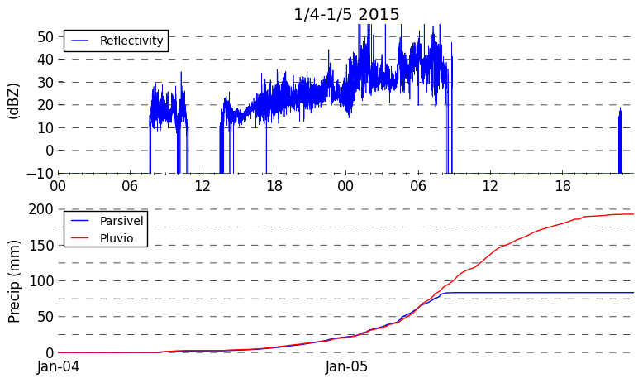
Heavy Precip. Event Jan 4-5, 2015
Snow Mix Rain
Missing data

Slide 17
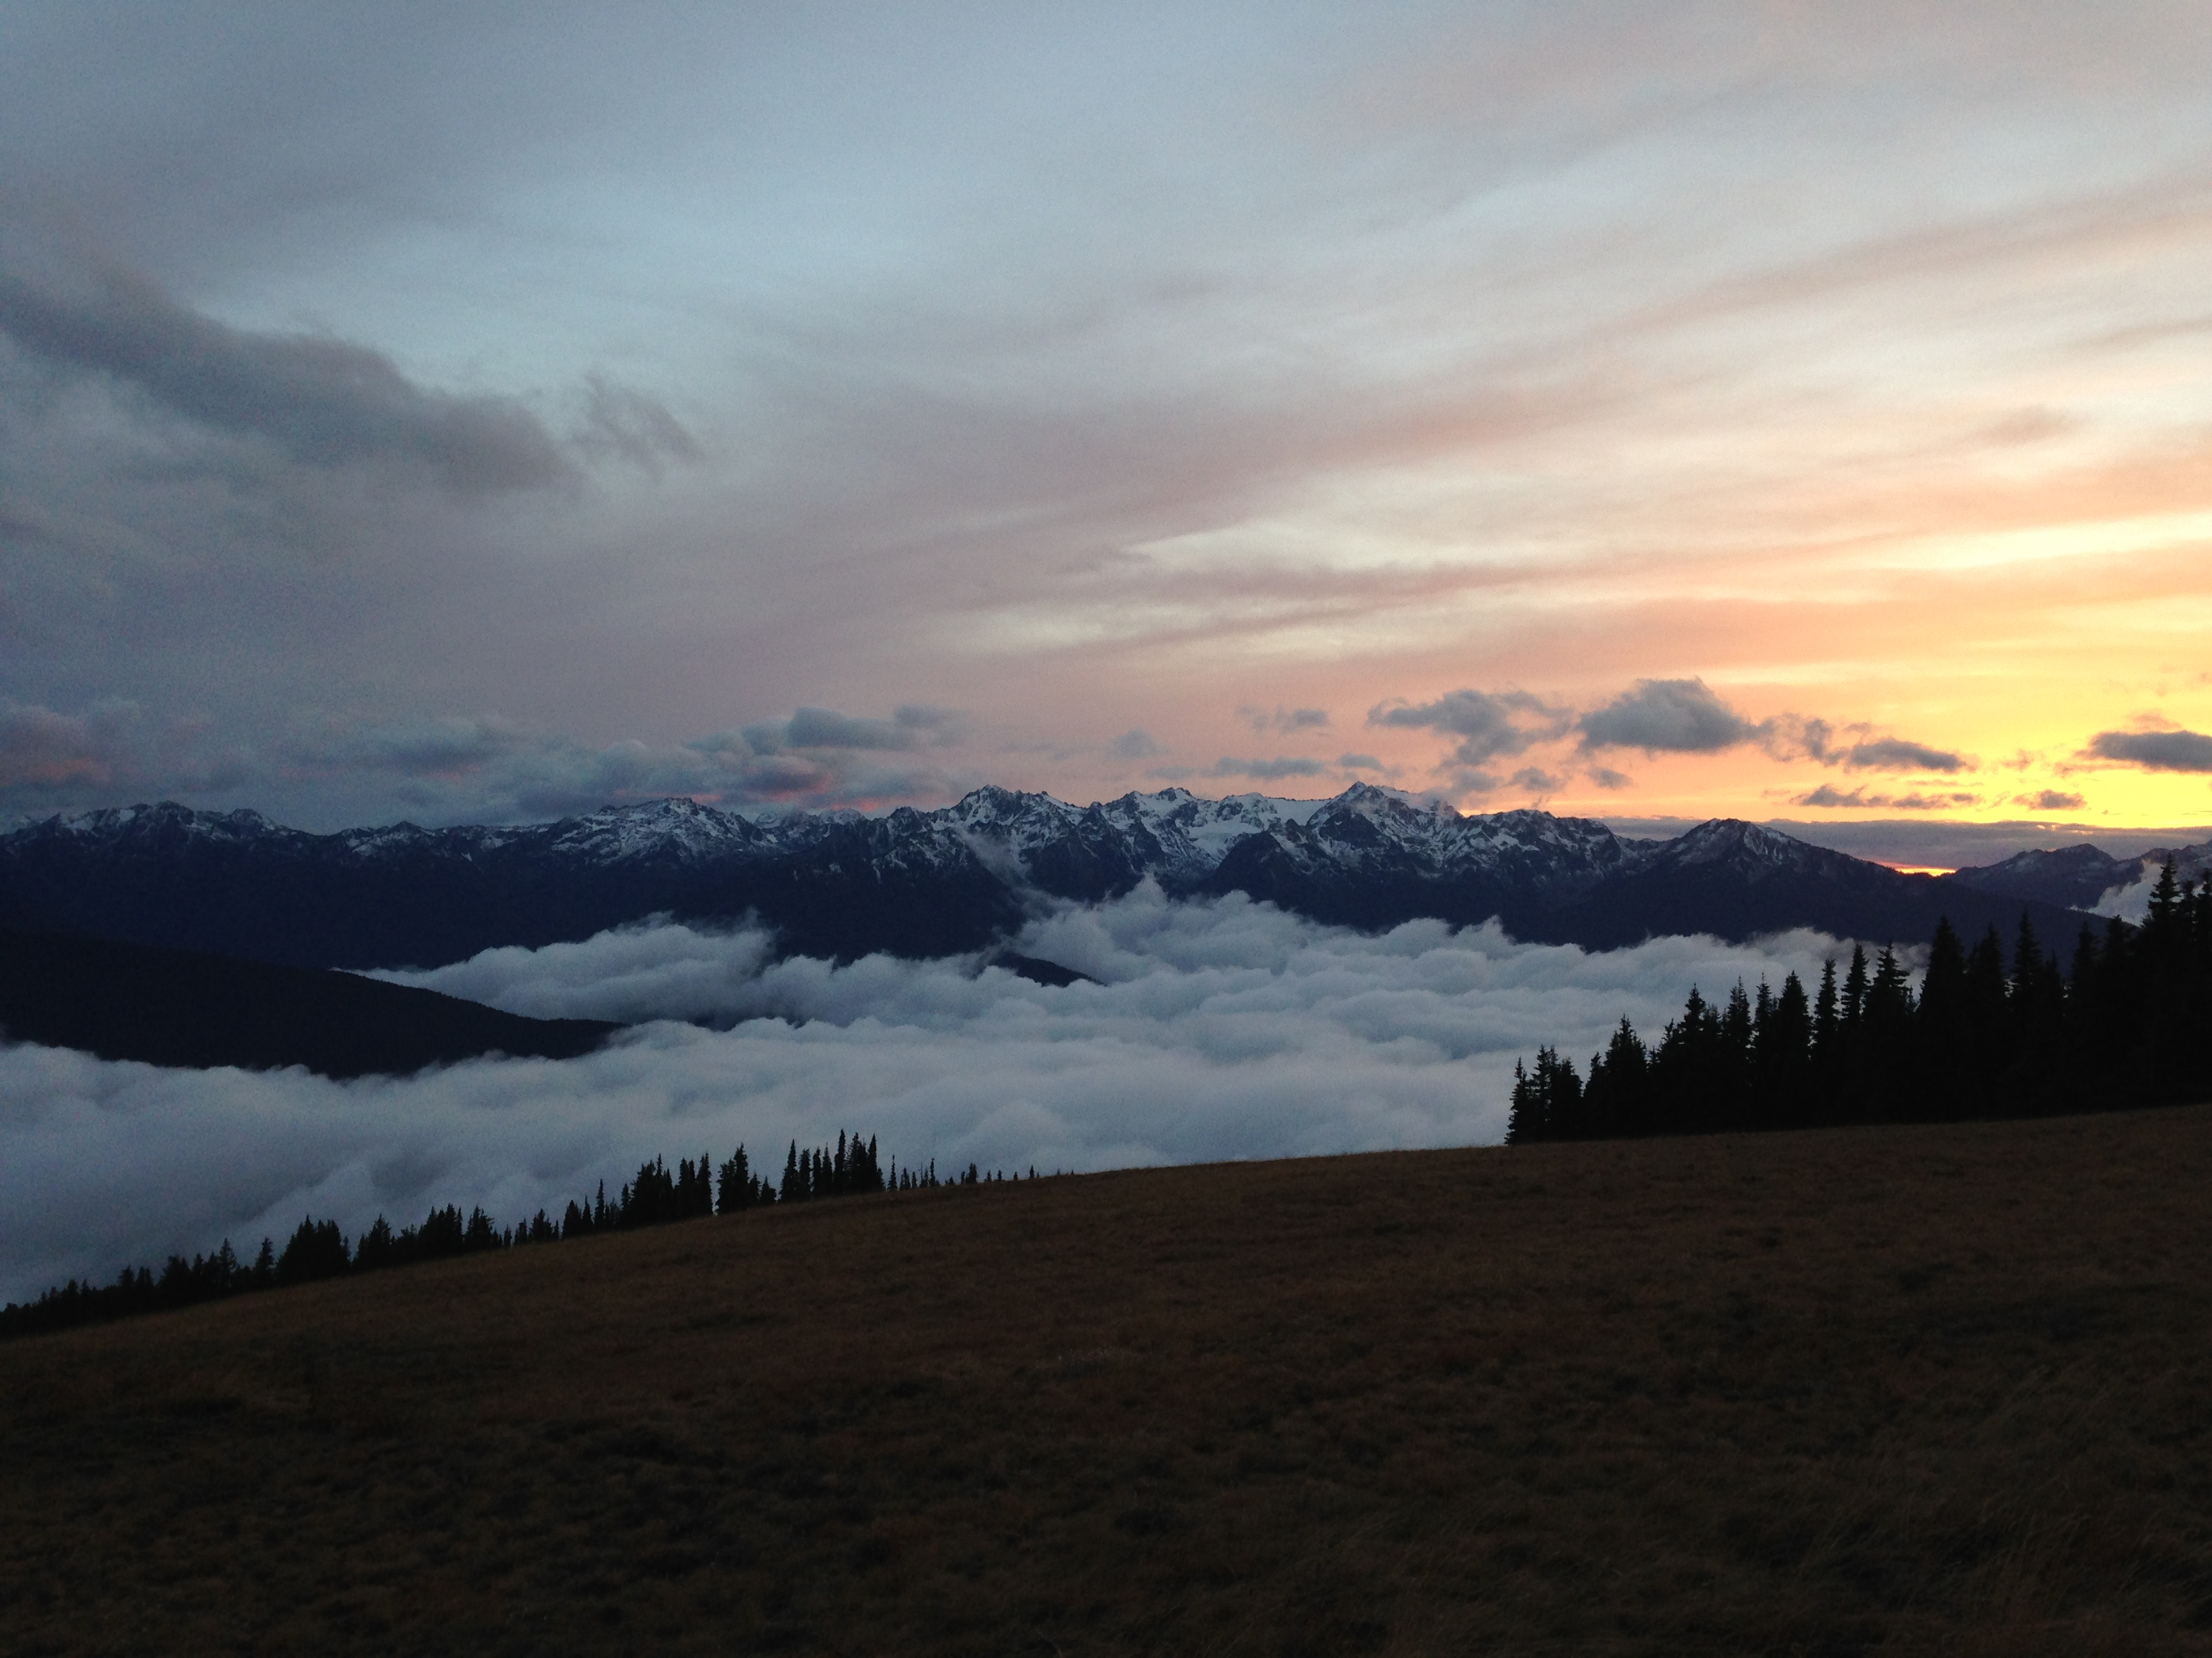
Hurricane Ridge

Slide 18
Name | Elev | Instruments X = currently deployed, P = Planned, U = Possible/Under Discussion |  |  |  |  |  |  |  | Power | Access
 |  | MRR | PIP | 2DVD | Parsivel | Pluvio | Hot Plate | Dual Tipping Gauge | Other
Lee Side
Hurricane Ridge | 5140’ | X | X |  | X |  | X |  |  | Yes | Road, Winter Conditions
Windward side (Quinault Valley region)
Wallace Cabin | Sea level | U |  | U | P |  |  |  | X= Tip Gauge | Yes | Road
Seed Orchard | 255’ |  |  |  | P |  |  | P |  | No | Road
Fish Hatchery | 170’ | P |  | P | X |  |  | X |  | Yes | Road
Amanda Park | 290’ |  |  | P |  |  |  | P |  | Yes | Road
Norwood South Shore Road | 220’ |  |  | U | P |  |  | P |  | Maybe | Road
Bunch Field | 380’ |  |  |  | U |  |  | P | X | No | Road, short walk
CRN Site | 285’ | P |  | P | P |  |  |  |  | Yes | Road
Graves Creek Campground | 563’ |  |  |  | P | U |  | P |  | No | Road and Trail
Neilton Pt | 2156’ | U | U | P | P | P | U |  |  | Yes | Road, Winter Conditions
Enchanted Valley | 2033’ |  |  |  | P | P |  |  |  | No | Trail
Wynoochee Trailer | 3160’ |  |  |  | X | X |  |  |  | No | Road, winter conditions, trail

Slide 19
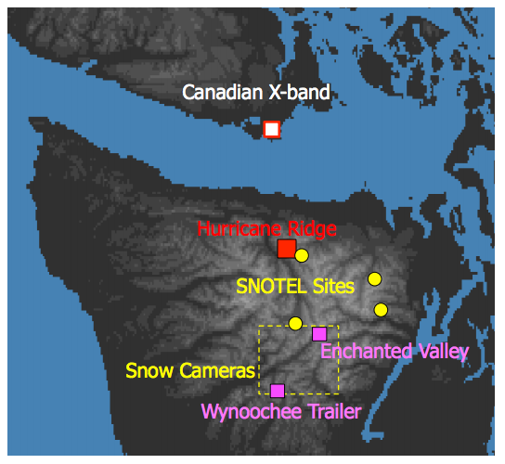
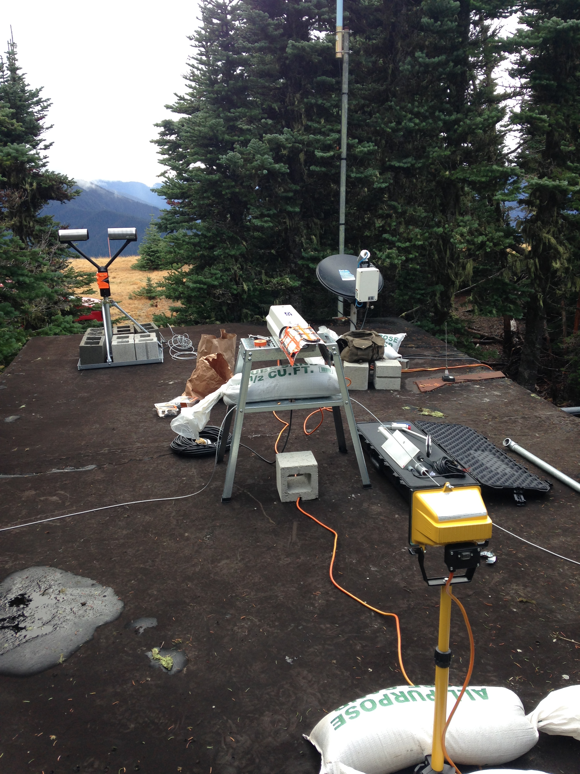
Hurricane Ridge
Data recording/transmission:
Cell coverage
Accessibility:
17-mile paved road, maintained weekends only
4+ hour drive from NPOL
Maintenance:
Snow/rime removal
PIP alignment/bulb replacement
Notes:
Example: PIP bulb burned out

Slide 20
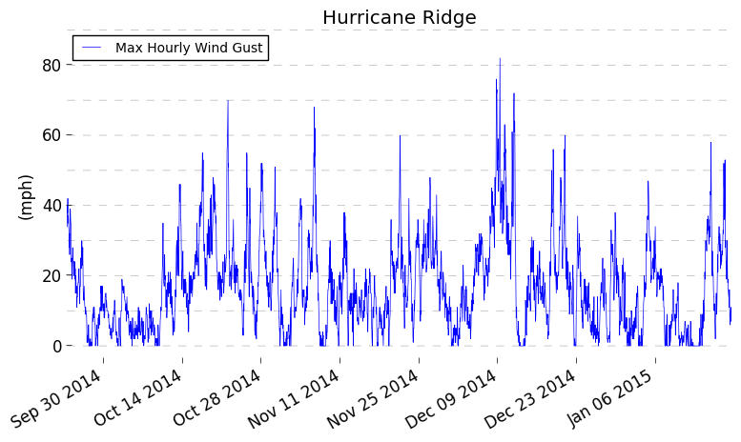
Wind Observations

Slide 21
Management Needs
Type | # Sites | Visit Frequency | Data Retrieval | Access Issues
Low elevation with power | 4 | 4-6 weeks, as needed | Cell | -
Low elevation, no power | 4 | 1-2 weeks, as needed | Site dependent | Mudslides
High elevation with Power* | 2 | 1-2 weeks, as needed | Cell | Snow, road closures
High Elevation, no power | 2 | 1-2 weeks, as needed | ? | No vehicle access
*Includes Hurricane Ridge
Notes:
*As needed is very important—after a major 10-15” rainstorm, all Pluvios will have to be emptied
*It is expected that snow/rime removal and heavier precip rates will require higher elevation sites to be visited more frequently

Slide 22
Extra Slides

Slide 23
Accessibility
Mudslides likely
13-mile backcountry trail
Unmaintained after Oct-1
Snow, mudslides possible
US-101
Maintained Dirt Road
Paved Road
Unmaintained Dirt Road

