Slide 1

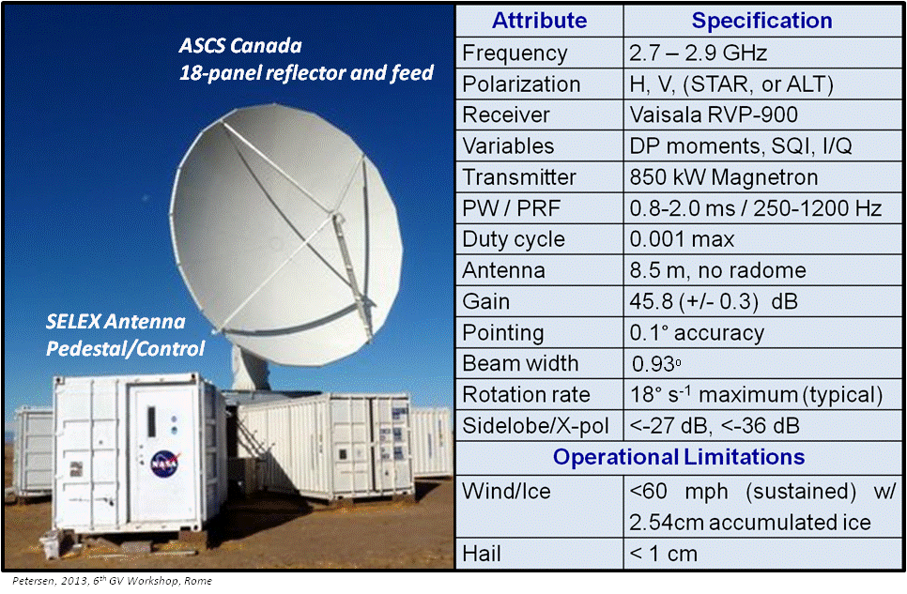

Slide 2

Radar Control / Scanning / Data Software (format): SIGMET (Vaisala) IRIS
  Processing: Typically PPP (dual-pol), FFT/DFT, Rphase, dual PRT,……
Remote / Continuous operations: Robust BITE system, Sensaphone monitoring
Scanning Flexibility (Temporal/Spatial sampling flexibility as needed)
360º PPI Surveillance or Volumes
PPI Sector Volumes: Azimuth sectors (0-360º) and elevations (0-90º) as desired
Range Height Indicator (RHI): 0-90º or other elevation as desired
Vertically pointing: ZDR Calibration and/or Profiling mode
Manual/Dwell (e.g., with ASCOPE and Antenna utility running)
Scanning scheduled and executed in repeating cycles as desired.
Petersen, 2013, 6th GV Workshop, Rome

Slide 3


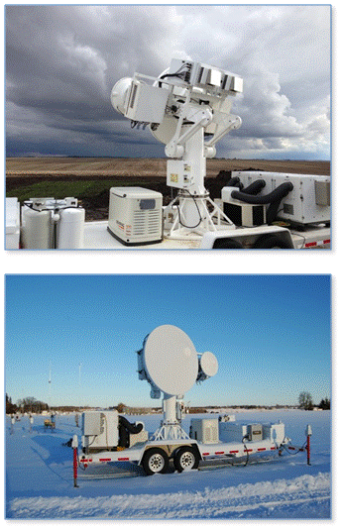
D3R: [Dual-Freq., Dual-Pol., Doppler Radar]

Slide 4
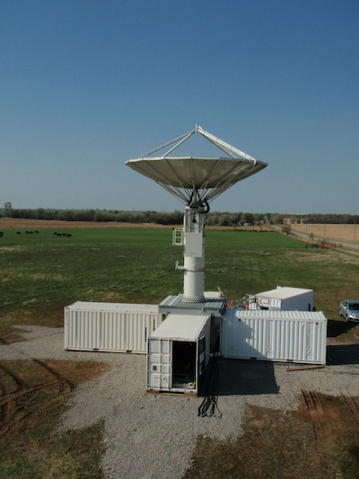
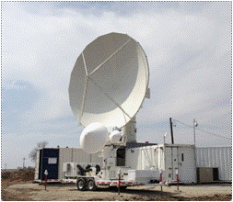
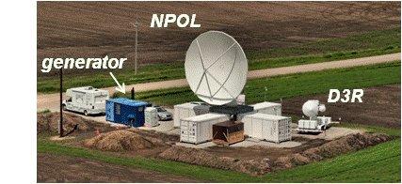
NPOL Radar & deployment requirements
  Transportable system consisting of six 8' x 8' x 20’ sea-containers weighing 5500-15000 kg when loaded for shipping
  Footprint ~100 ft x 100 ft: including five containers, one generator, center plate “stable base” and D3R.
  The soil bearing capacity must be 1500 lbs/ft² under center plate
  Concrete surface preferable but not required. If soil not of sufficient bearing capacity, structural fill (e.g. CR-6) is used.
  The site must be stable, compact and level, and must not be subject to flooding, standing water, or erosion
  NPOL operates on commercial or generator power. Diesel generator will be used for OLYMPEX

Slide 5
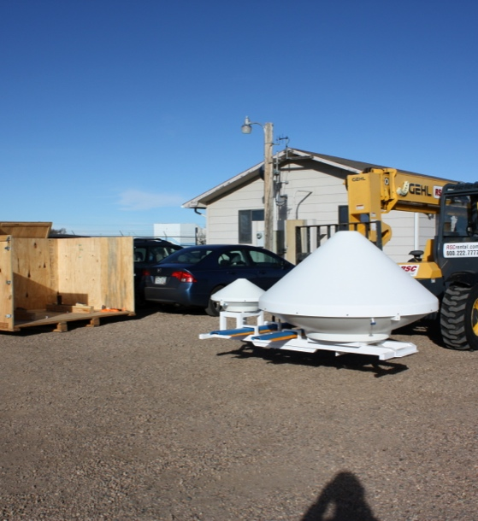
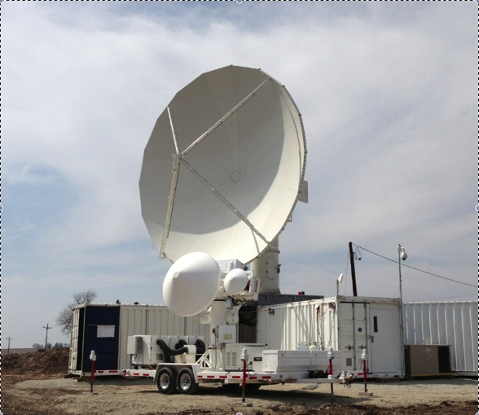
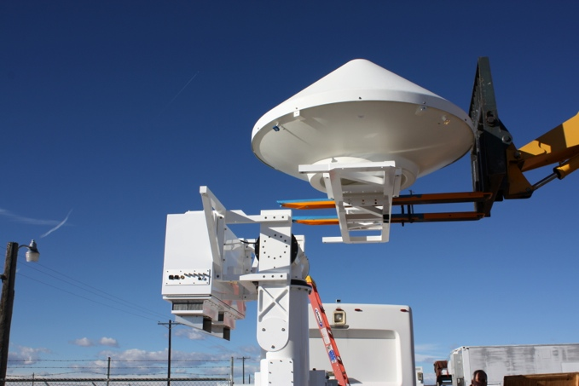
D3R OLYMPEX Deployment
Power: 208 V, 60 Hz, 50A (provided by connection to NPOL generator container)
Cell communications for remote instrument monitoring and control (separate from NPOL)
Graphical user interface setup in NPOL science container
Setup
  Antennas and IF electronics shipped separate from trailer and towing vehicle
  Forklift required to handle antenna and IF electronics box.
  High level summary of instrument assembly below.
  Typically ready to operate within 1-2 days.
High Level Assembly Procedure

Slide 6
D3R OLYMPEx Deployment

Slide 7
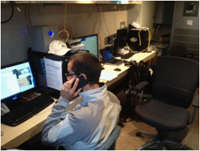
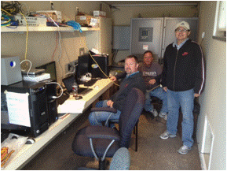
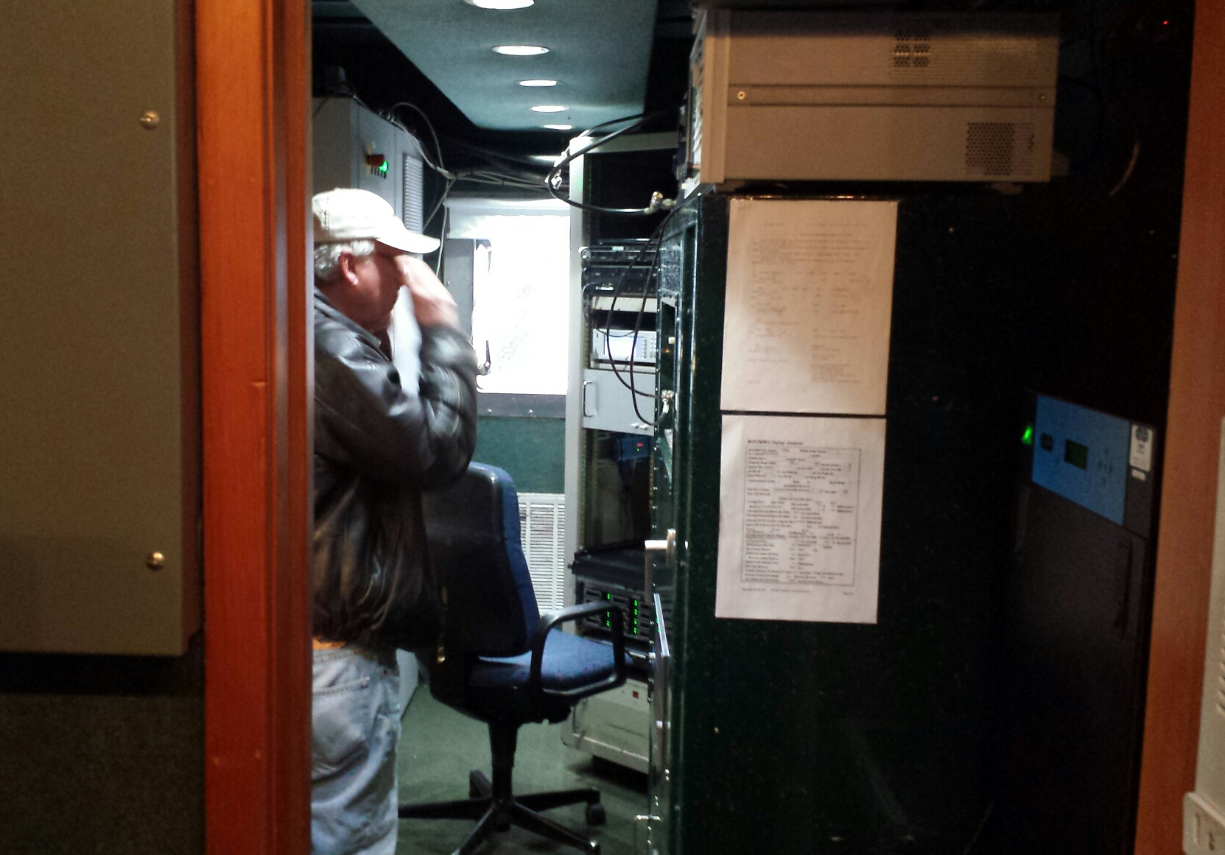
  Science container: Space for ~4 scientists. Scan and product config/radar ops/data products, analysis and archive for NPOL; D3R control/ops, data archive; UPS
  Radar container: Engineering HQ (space for 2). Radar control, TX/RX, ACU, test equipment, compressor etc.
  Comms/Data:
      External voice/Data comms via cell/cell modem [D3R on own, separate modem]
      Data will be sent to GSFC and/or UW servers. Field-limited 8-bit NPOL data are sent. D3R moment data and imagery can be made available in NRT.
      Archive: Full 16-bit dataset will be archived at the site on a RAID system and can be copied to portable USB drives as needed/desired
    Ops: Wind < 60 mph sustained, gusts to 70; can survive 120 mph stowed; can operate with up to 60 mph with 1” of ice on reflector (not yet experienced!).

Slide 8
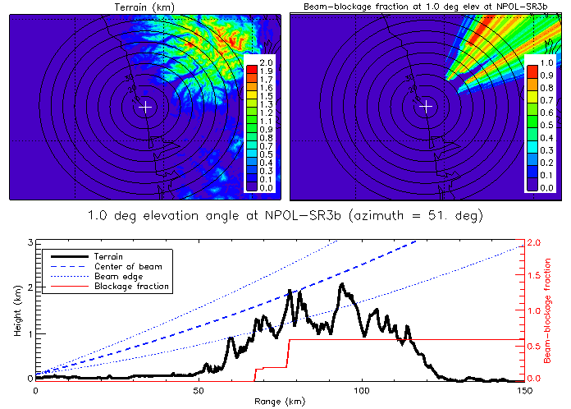
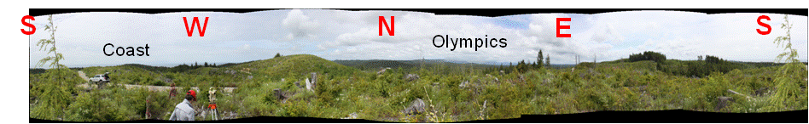
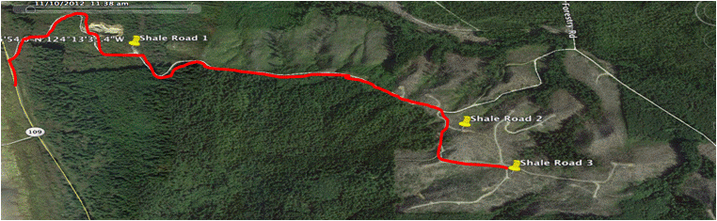
NPOL/D3R Site: Shale Road – SR3
(Quinault Reservation Land)
Location
Elev. 455’
47°16’31.9”N
124°12’32.6”W
Courtesy L. McMurdie

Slide 9
NPOL/D3R OLYMPEX Considerations
  Site and Install
    Site chosen and will host both NPOL and D3R in standard configuration (D3R located in one sector of NPOL seatainers and using NPOL power).
    Still waiting for final approval on site use from Quinault Tribe. Must establish lease. Questions on road surface/access (damage from storm; road prep).
    Set up planned for NPOL and D3R well prior to OLYMPEX; NLT mid-September 2015*. Grading and site prep to be completed prior to arrival of radar system [*Considering Nov. deployment of D3R]
    A road will be constructed between existing road and radar footprint. Must handle D3R, 18-wheelers, 60 ton crane, basket truck, etc. to place radar containers on center pad
    NPOL reflector install requires winds < 20 mph w/a minimum of 6-8 people (UW students, locals?)
    Installation time: 5-7 days for NPOL (1-2-days for D3R) of GOOD weather
  Security:
    Once installed, but prior to campaign, no personnel on station. We will NOT run the cables or generator until we return for the campaign; similar issue over Christmas.
    Planning to build, minimally, a 6’ fence with barbed wire around site. Security.
  Generator :
    Main generator serving NPOL/D3R recently tested should be reliable (minimal hours). Between tanks, usable fuel ~1175 gallons; Will service every 8-9 days, refuel every 10 days to be conservative (burn ~75 gal/day).
    D3R also has a back up generator and can be fueled and ready if needed.
    Need to secure a fuel company; diesel mechanic, and HVAC prior to campaign

Slide 10
NPOL OLYMPEX Considerations (continued)
  Staffing
    Field deployment safety dictates that a minimum of 2 people be on site at NPOL/D3R at all times during ops.
    During operations, site will be staffed by minimum of one engineer (usually a mix between D3R and NPOL) and one scientist. For assumed 24/7 ops, and “canned scanning” at least five people must be in the field to handle radar ops at any given time between NPOL and D3R (12-hour shifts)
      2 NPOL engineers (who can also run radar for ops if needed)
      1 D3R engineer/scientist
      2 Radar Scientist (covering key ops periods)
      Remote monitoring by other radar scientists w/feedback to onsite engineers is possible.
    Schedule a hard down day at least once every 7 days for 12-hour shifts.
    Lodging
    Currently planned for Navy Pacific Beach Resort near Moclips (~15-20 min. South of NPOL/D3R). Other rental homes/locations in area seem possible.

Slide 11
EXTRAS

Slide 12
D3R OLYMPEx Deployment
Notes/assumptions on deployment
  Looking at leaving late Aug early Sept to avoid setting up and driving instrument in wet weather. ( Q Can D3R be set up much after NPOL )
  Instrument setup to be done on location with enough room to maneuver forklift
  Possibly setup D3R at NPOL container shipment site and drive up to final deployment site. 4) Verizon comms are expected to be available (tower visible from site, some reception on cell during visit to site)
  Operations Nov 10-Dec 21 followed by 2wk break (possibly full shutdown) and another 2wks of operations ending in Jan-15. No operations after setup until Nov 10.( This is a weakness)
  No commercial power so continuous diesel gen ops are expected with regular refueling and possible maintenance stops approx. every 9 days. D3R is hooked up to NPOL so no real action on D3R side on this. D3R should possibly keep its generator fueled and on standby in case the NPOL gen fails. Our transfer switch breaks and then makes the connection so no feedback issues are expected.
  Fence with barbed wire planned. Cameras will be installed and NPOL staff is looking into contracting local security while on break.
  100x100 ft crush and run planned, no cross pattern, full square so D3R fits within containers as done in Newark, MD
  Site will be staffed by at least 2 NPOL engineering personnel (not sure about local scientist presence). We are planning for 1 person responsible for D3R operation, monitoring and reporting ( supplied by CSU )

Slide 13
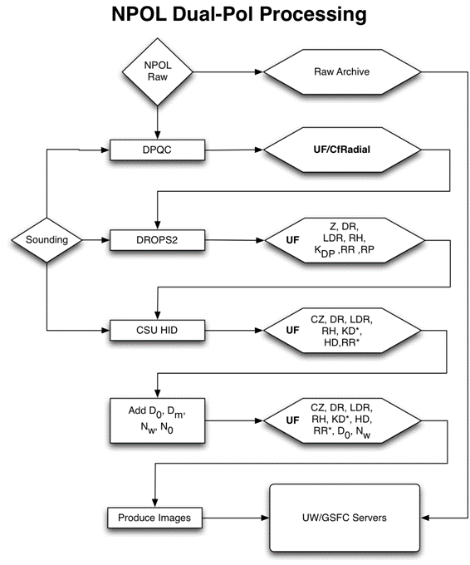

Slide 14
