Slide 1
X
X
X
X
NPOL & D3R
DOW
EC X-Band
WSR-88D
X
MRR
Figure 14: Locations of all the available ground radars for OLYMPEX and the RHI scanning regions for NPOL and EC X-band.

Slide 2
Attributes of suggested modules
Suitable for any of the 3 sectors
prefrontal
frontal
postfrontal ,
Are short enough that they can be repeated within a given aircraft deployment
Can be executed singularly or in multi-aircraft mode
Can cover the Quinault
Oceanic upstream of the Olympics
windward side over the Quinault y network
leeside Hurricane Ridge sector
Can be shifted to the Chehalis for storms to the sout of the Olympic Range
Can be interspersed with a module to underfly a satellite overpass

Slide 3
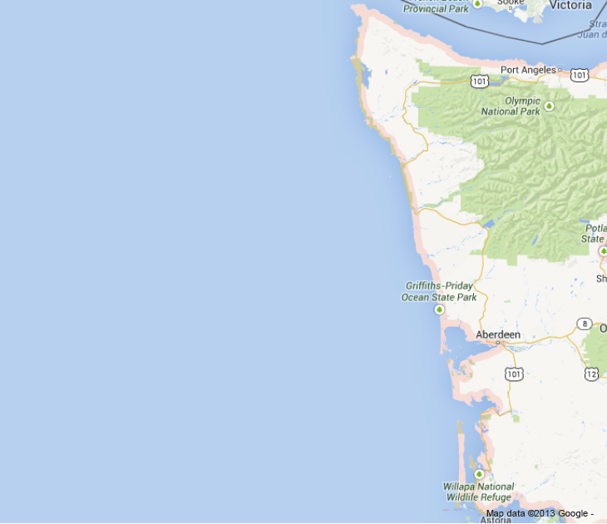
X-band
ER-2 modified butterfly pattern
NPOL
ER-2
Figure 16: Generic flight module for the ER-2 aircraft

Slide 4
X-band
Generic DC-8 pattern with dropsondes at white circles
NPOL
DC-8
Figure 17: Generic flight module for the DC-8 aircraft.

Slide 5
X-band
Generic Citation pattern with spiral at circle
Citation
NPOL
Figure 18: Generic flight module for the Citation aircraft.

Slide 6
X-band
All aircraft with stacked pattern over Quinault River ground instrumentation
Citation
NPOL
ER-2
DC-8
Figure 19: Generic coordinated aircraft flight modules.

Slide 7
Roles in Operation
OLYMPEX Lead Scientist (OLS) – Bob, Walt, Lynn, Steve, …
RADEX Lead Scientist (RLS) – Jay, Roger, …
Aircraft Project Manager (each aircraft) (APM) – Chris (DC-8), Mike (Citation), Fran (ER-2)
Aircraft Mission Scientist (AMS) DC-8 and ER-2
Flight Coordination Director (FCD) – Jan, backup
Platform PIs

Slide 8
Operations Center
Location for daily meetings and small conferencing:
2 rooms, 6th floor, ATG Bldg.
Location for communications (Jan)
Basement ATG Bldg.

Slide 9
Daily Meeting
Weather briefing
Lynn’s UW crew
Project status review
Status of all platforms and instruments
Plans for the next 2 days
surface observations
radars
soundings
aircraft

Slide 10
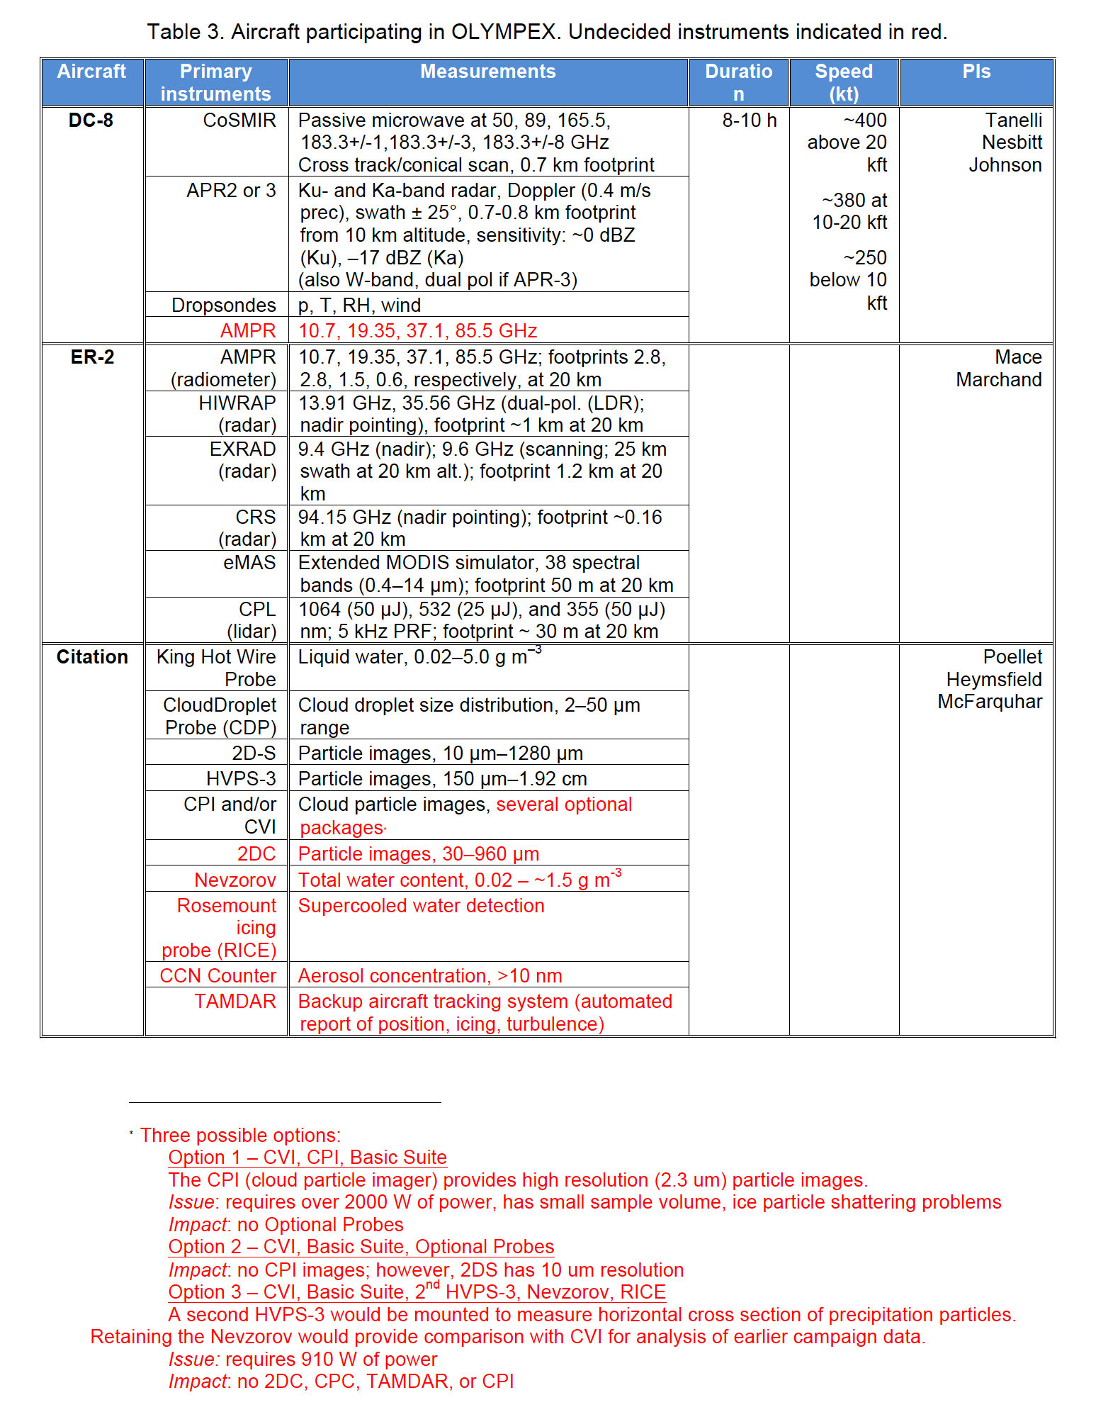

Slide 11
Enchanted Valley
Tipping Bucket Network
Bunch Field
CRN Site
Graves Creek
Amanda Park
DOW
Norwood
Wynoochee Trailer
Neilton Pt
Fish Hatchery
NPOL
Seed Orchard
Wallace Cabin
= Low Elev. With Power
= Low Elev. No Power
= High Elev. With Power
= High Elev. No Power
Figure 8: Locations of the surface network (triangles)and the NPOL and DOW radars (squares) deployed for OLYMPEX. See Table 1 for the instruments to be deployed at each station.

